Slide 1
Development of Reduced-Order Models Representing Landscape Evolution
Rawser Spicer
Committee: Orion Lawlor, Bob Bolton, Glenn Chappell

Slide 2
Goal
The goal of this project is to develop reduced order models (ROMs), and parameterizations from the Alaska Thermokarst Model (ATM). ROMs reduce complexity in models to gain increases in speed at runtime
Results from the ATM will be used to develop reduced order models to integrate into the Department of Energy (DOE) Energy Exascale Earth System Model (E3SM) Land Model (ELM).
Complexity differences
ATM has 1km² grid which track details about permafrost, and landscape types (cohorts) as fraction of total area
E3SM has 10km² grid and is concerned with the carbon, and energy fluxes which may be single valued floats

Slide 3
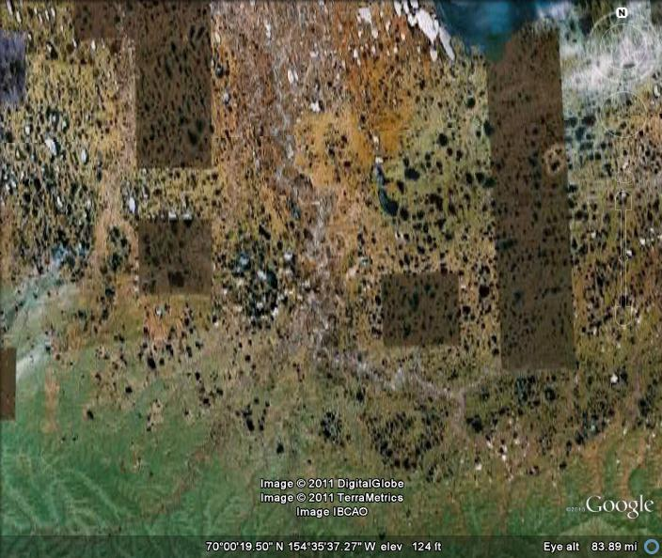
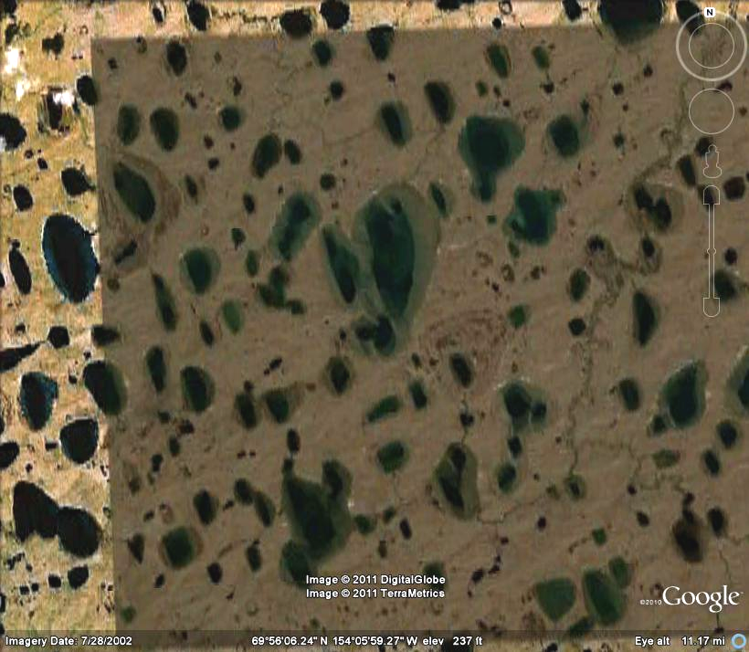
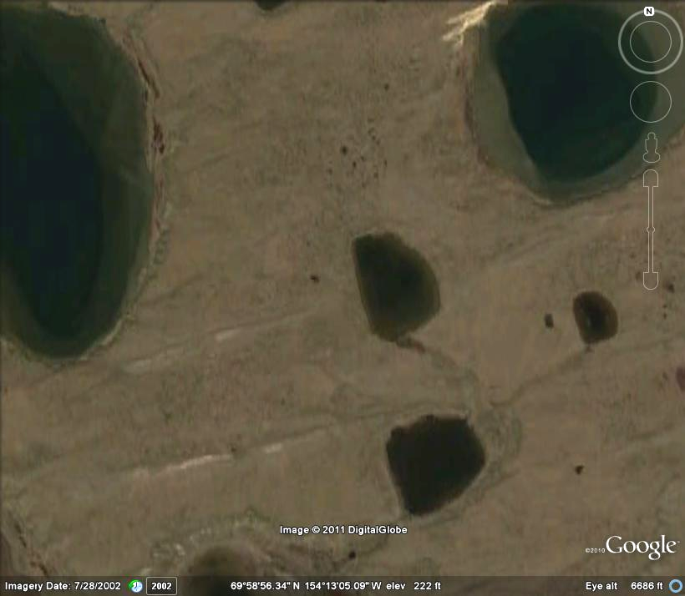
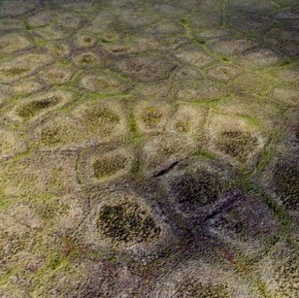
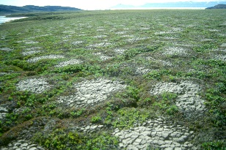
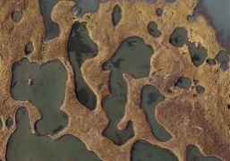
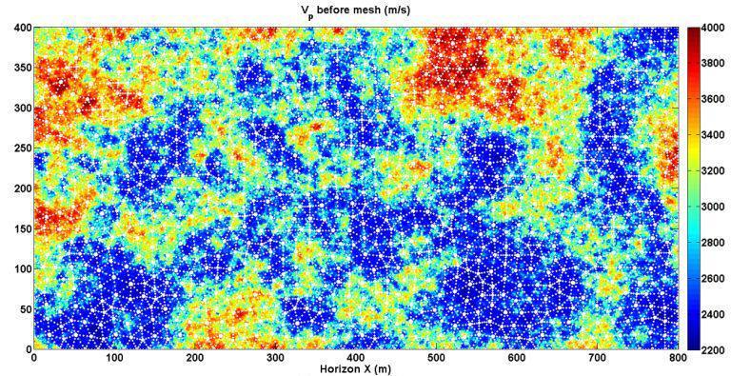
10 km
1 km
100 m
10 m
1 m
Climate Models and Data
NGEE Process Studies
Climate Model Parameterization and Upscaling
Process Study Integration
Intermediate-scale modeling

Slide 4
Science
Permafrost?
Permafrost is continuously frozen soil that occurs in arctic regions.
Thermokarst?
Thermokarst features are topographic depressions created in a variety of shapes and sizes as a result of thawing ground ice.
Estimated 1700 billion tons of organic carbon stored in northern soils
Amount, rate, and form of carbon release is unknown, but is tied to permafrost thaw
Permafrost thaw & subsidence are also tied to habitat change

Slide 5
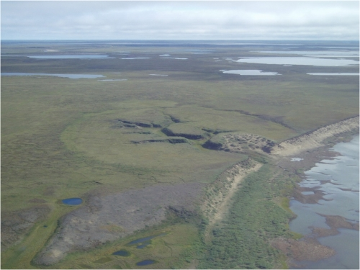
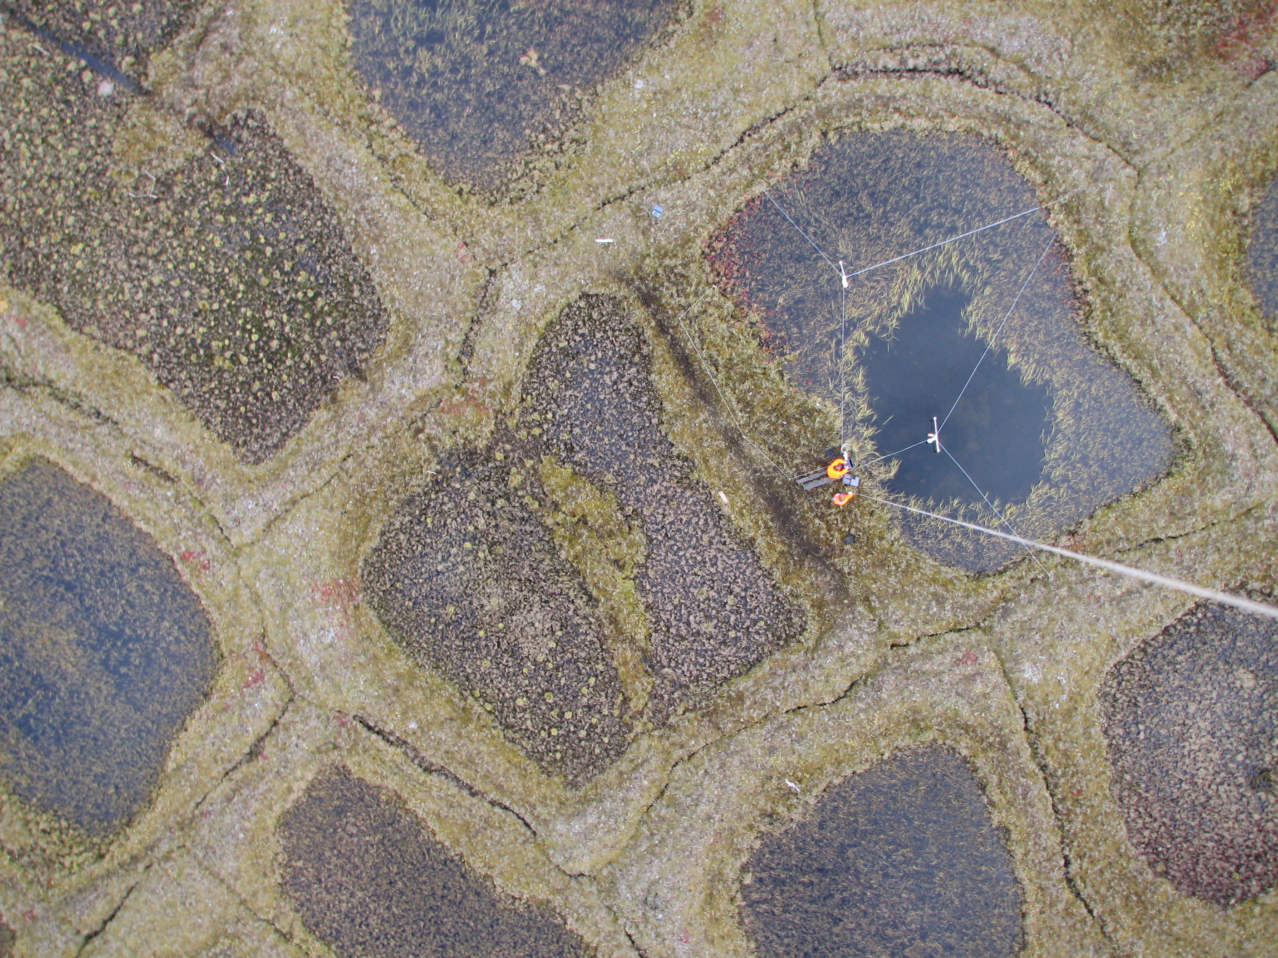
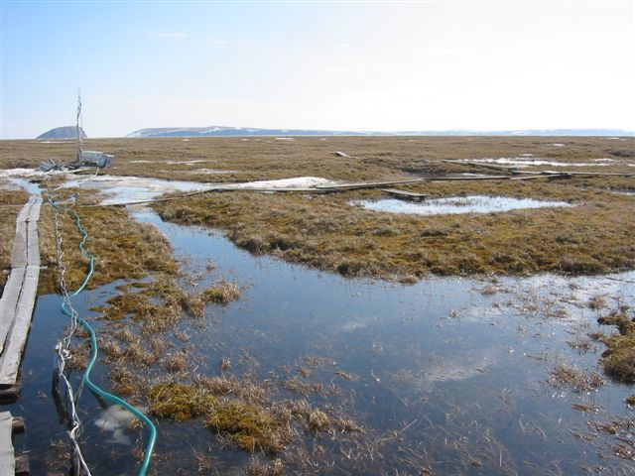
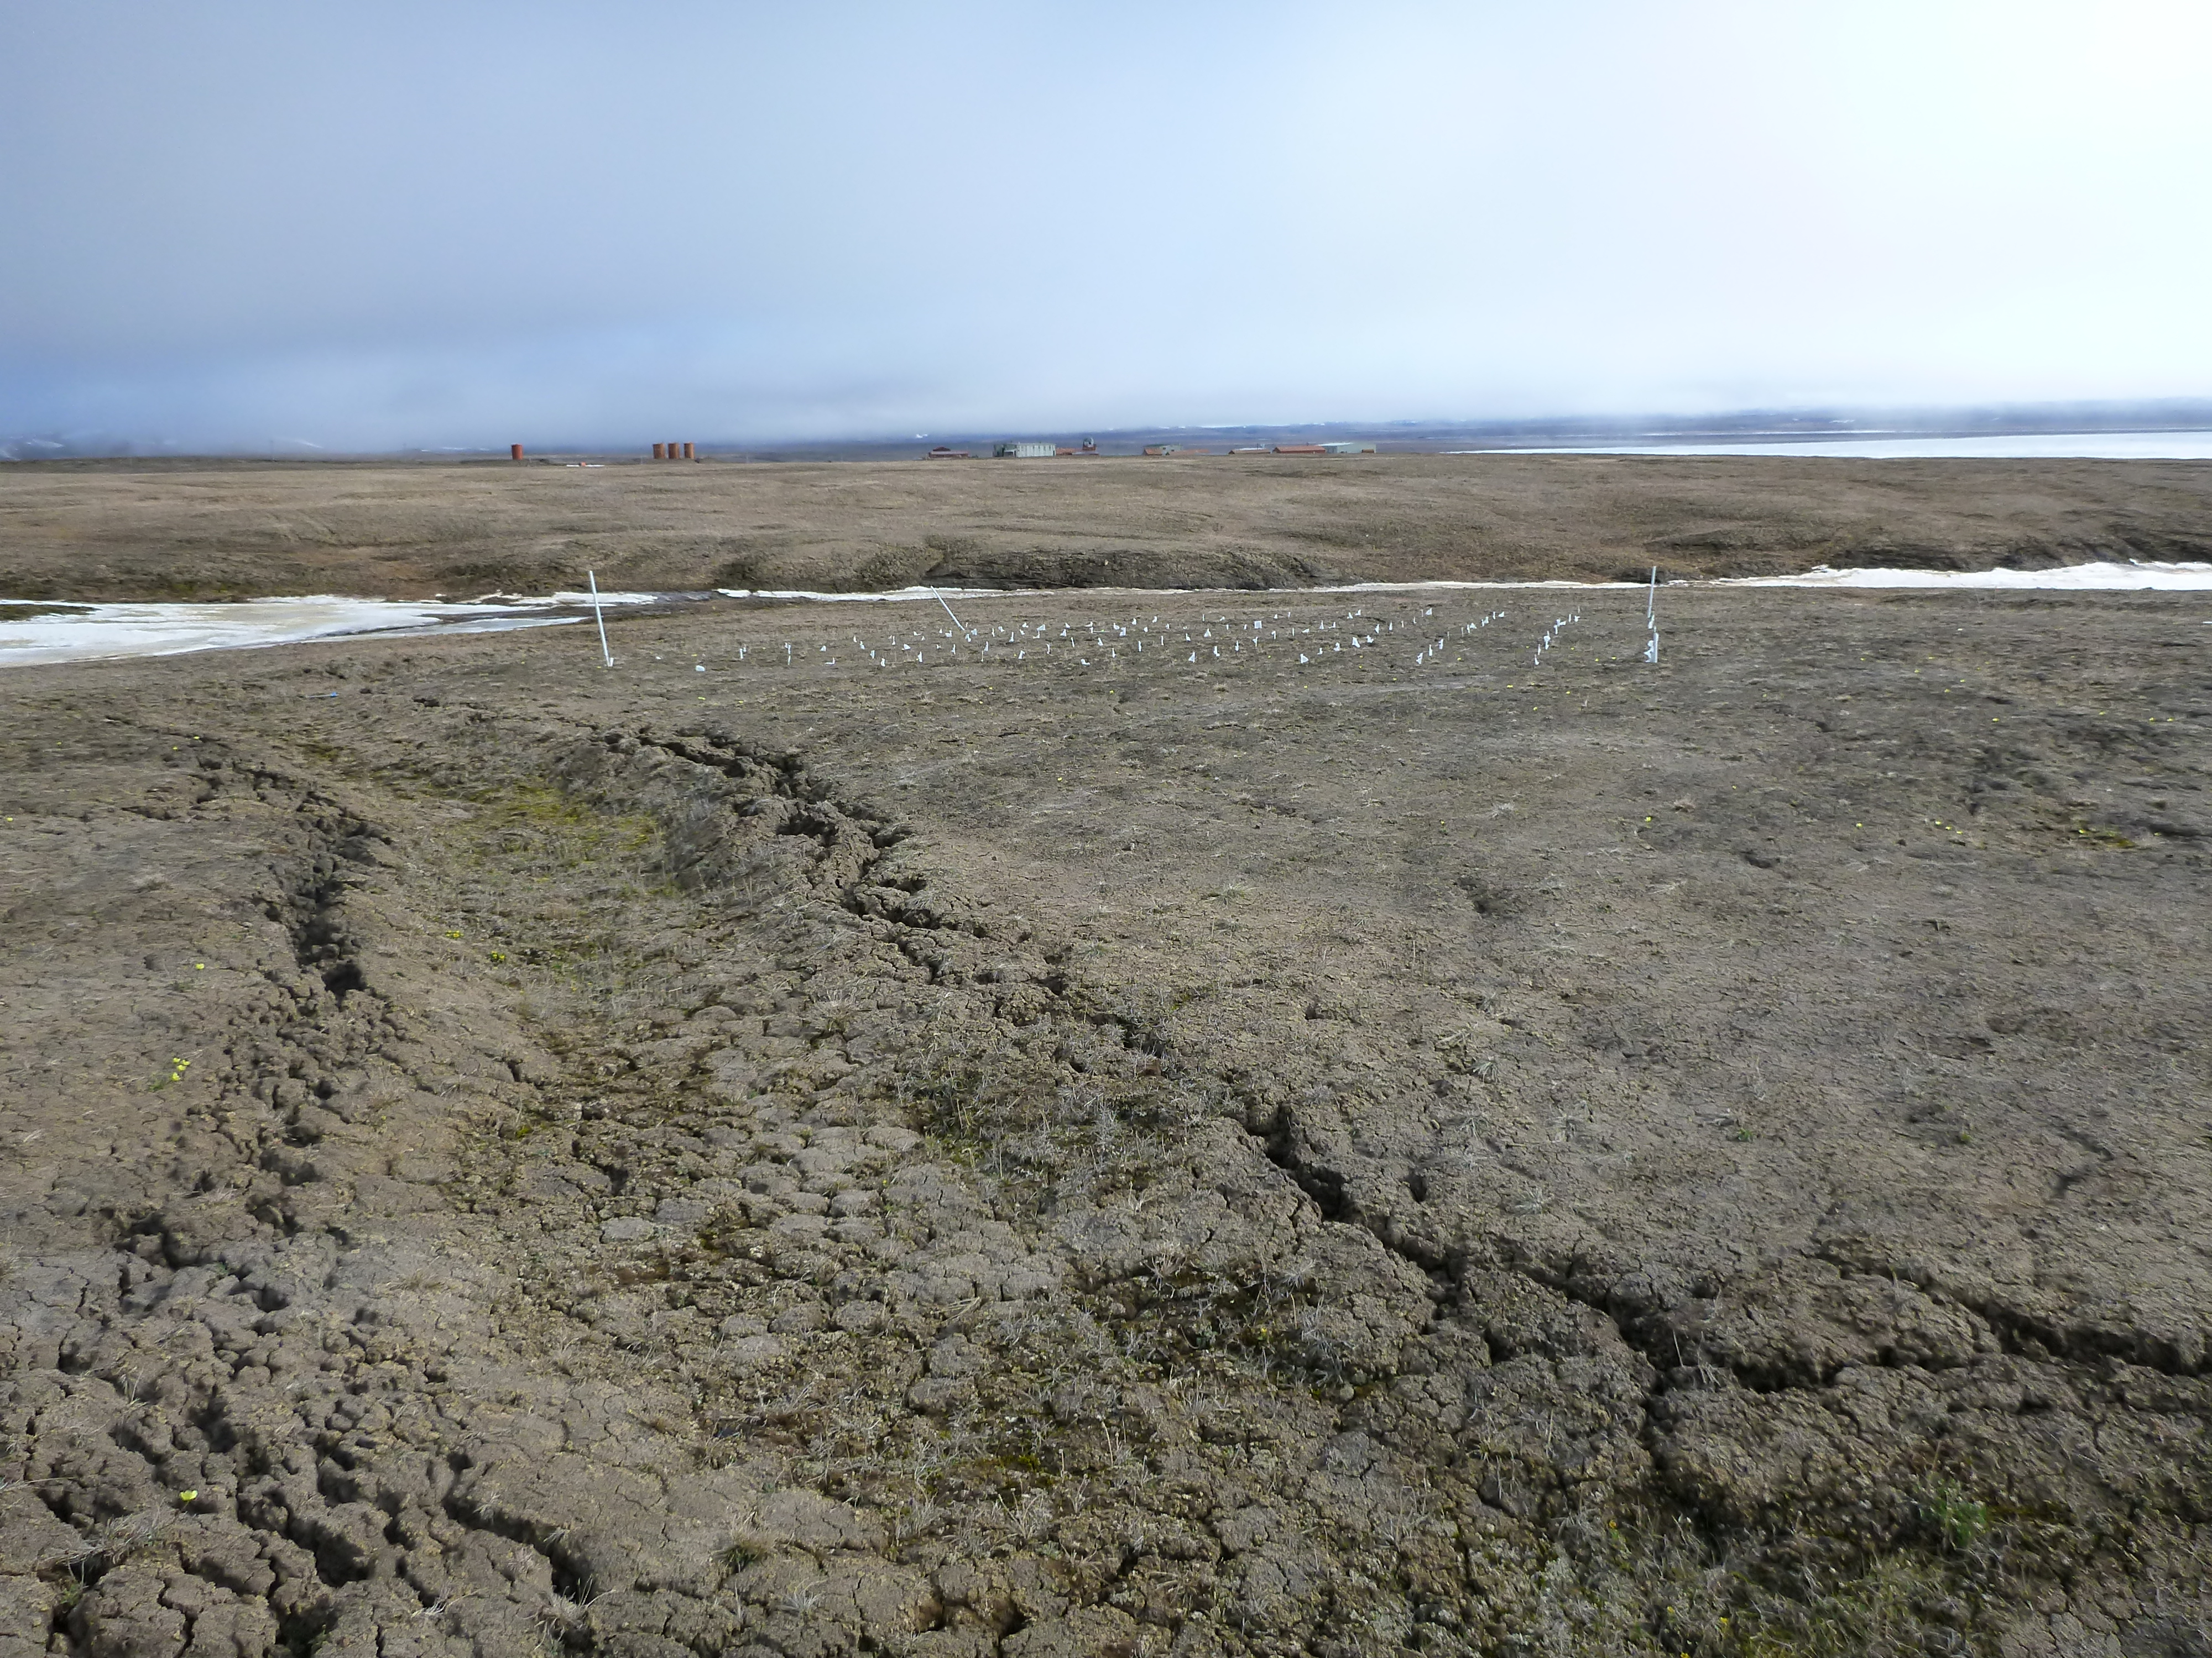
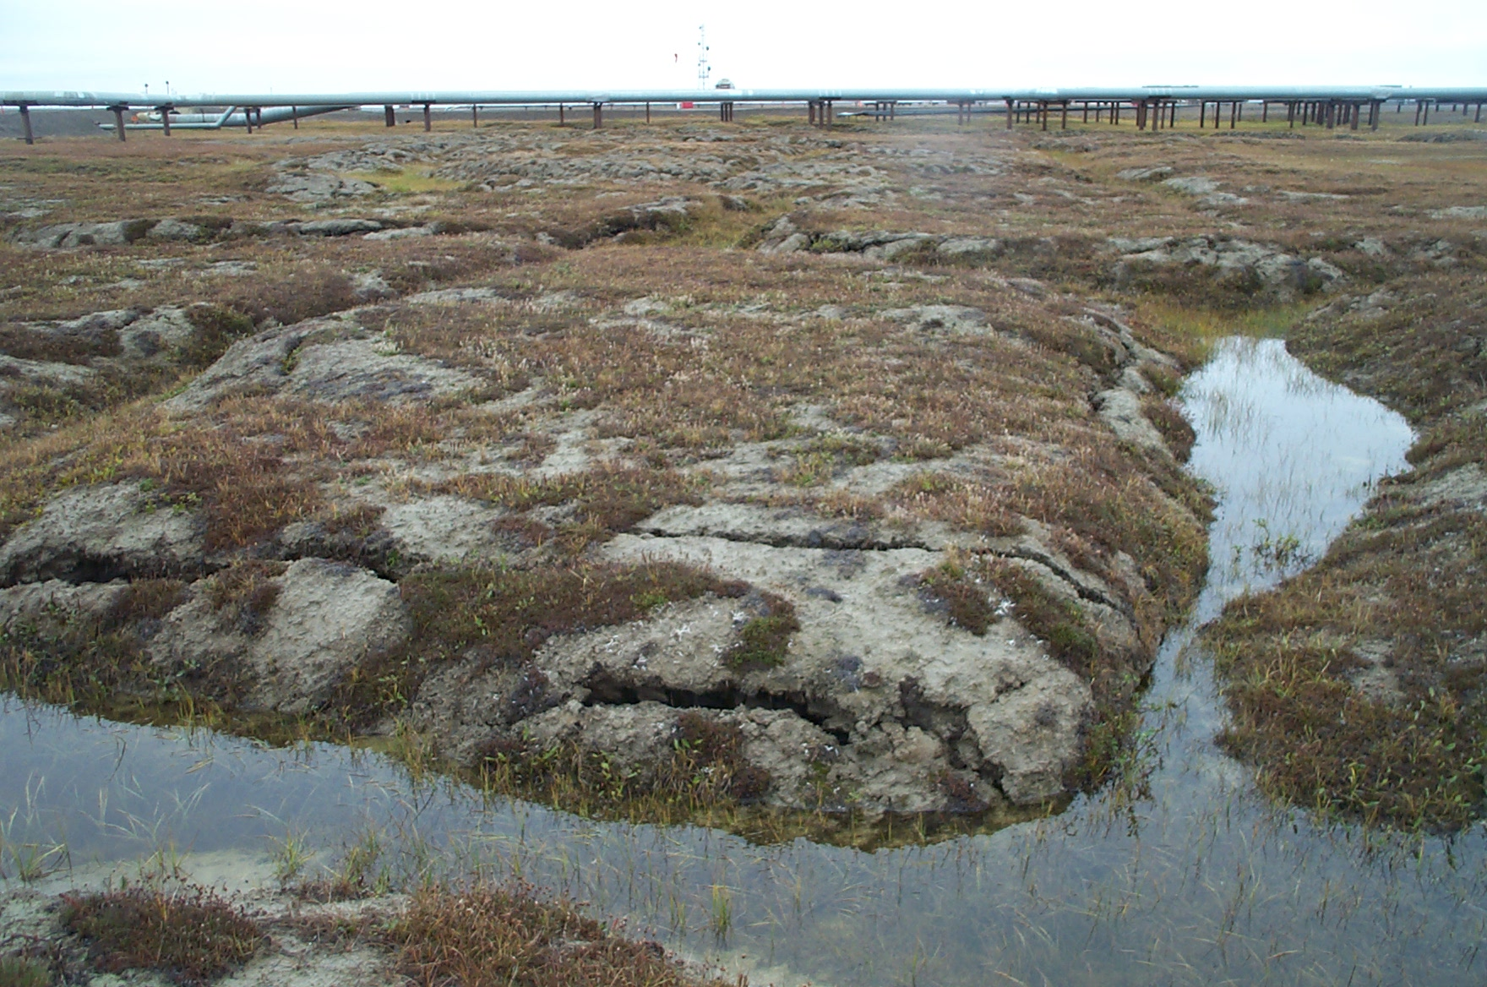
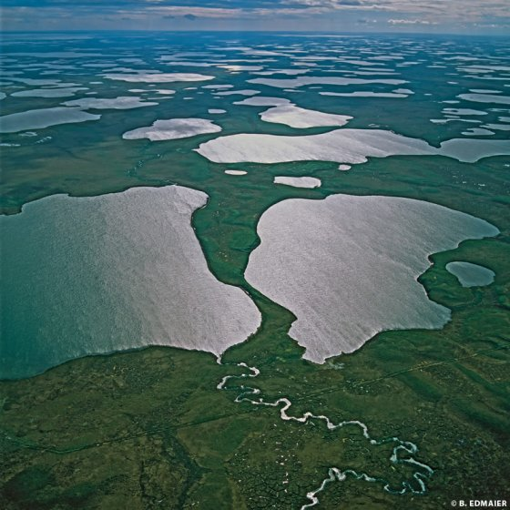
Non-Polygonal Ground
Low Centered Polygon
Coalescent Low Centered Polygon
B. Jones
J. Boike
T. Sachs
V. Romanovsky
L. Hinzman
IPA Website
Flat Centered Polygon
High Centered Polygon
Lakes

Slide 6
Alaska Thermokarst Model
Goal of the ATM is to develop and apply a landscape evolution model that is capable for forecasting how landscape structure and function might change in response to how climate change influences interactions among disturbance regimes, permafrost integrity, hydrology and vegetation succession and migration.
The Alaska Thermokarst Model (ATM) is an intermediate-scale, state-and- transition model designed to simulate the transitions caused by thermokarst disturbance
Model Characteristics
State and transition model
tracks cohorts by fractional area of model element (NOT spatially-explicit)
1 km² resolution
1-year time step, simulation period ~100 years from current

Slide 7
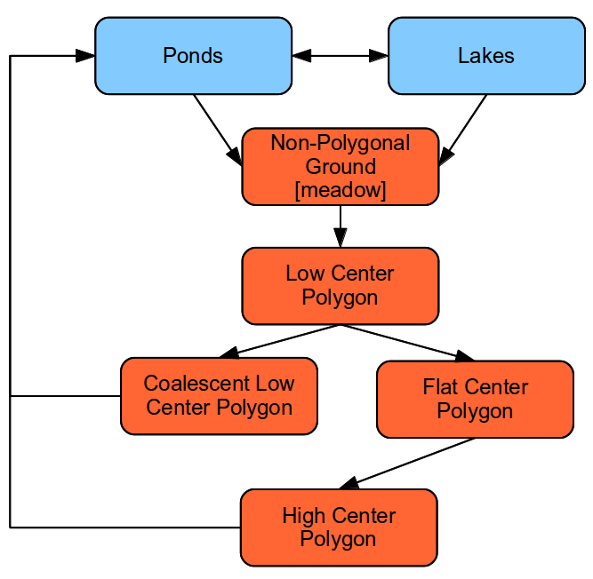

Slide 8
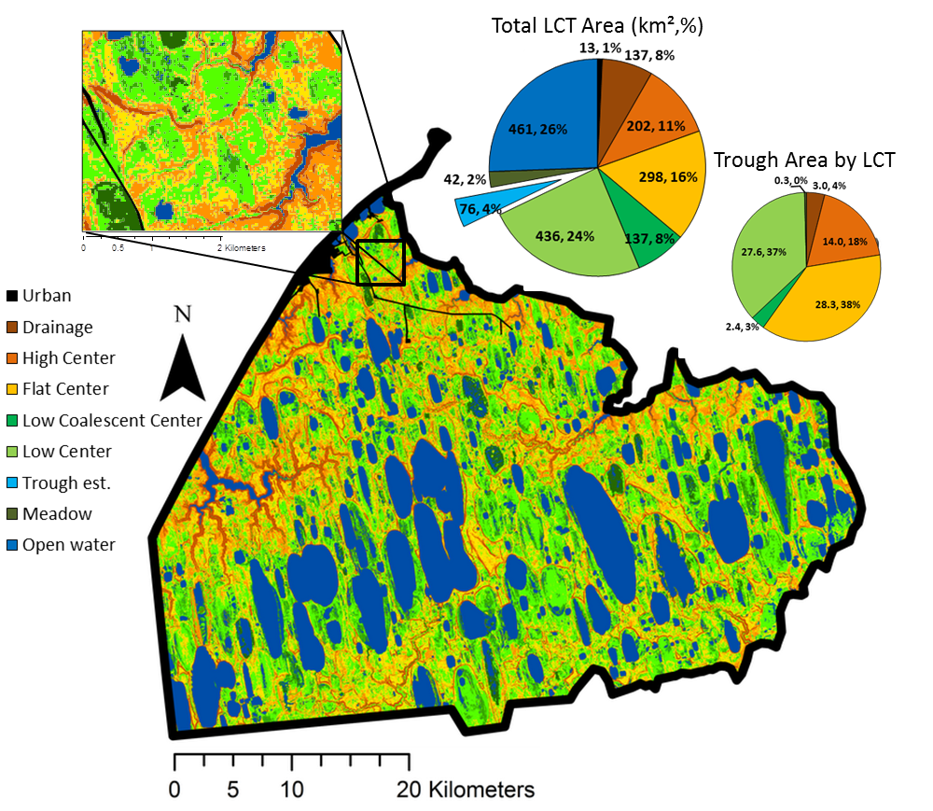
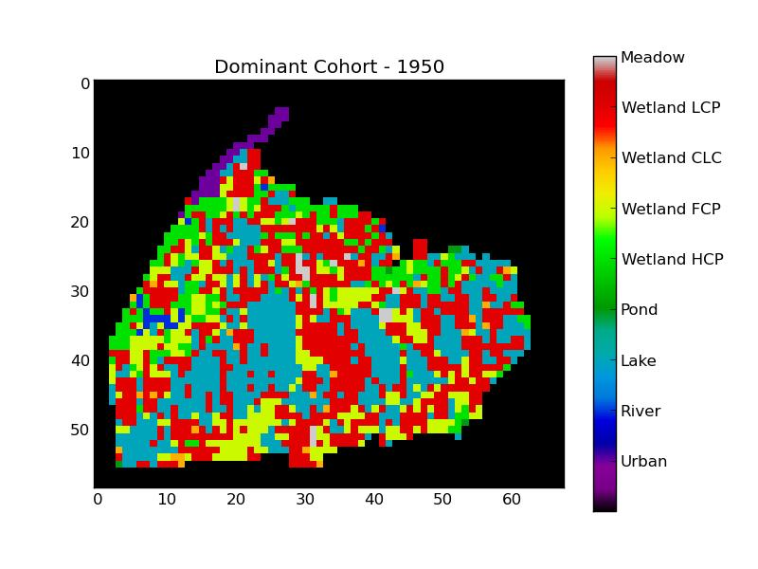
Tracks cohorts by fractional area of model element
Lara et al., 2014

Slide 9
Alaska Thermokarst Model Code Details and current performance
Python
Model configuration uses YAML
~7000 lines of code
Performance
Initial version runtime ~35 mins
Current version ~5 mins

Slide 10
Reduced Order Models
Reduce complexity in models to gain increases in speed at runtime
Properties
Small Approximation error
Preservation of stability/passivity
Computationally efficient
Methods
Krylov-based methods
SVD-based methods
Examples
Wave surge forecasting
Air quality simulations
Vibration/acoustic systems

Slide 11
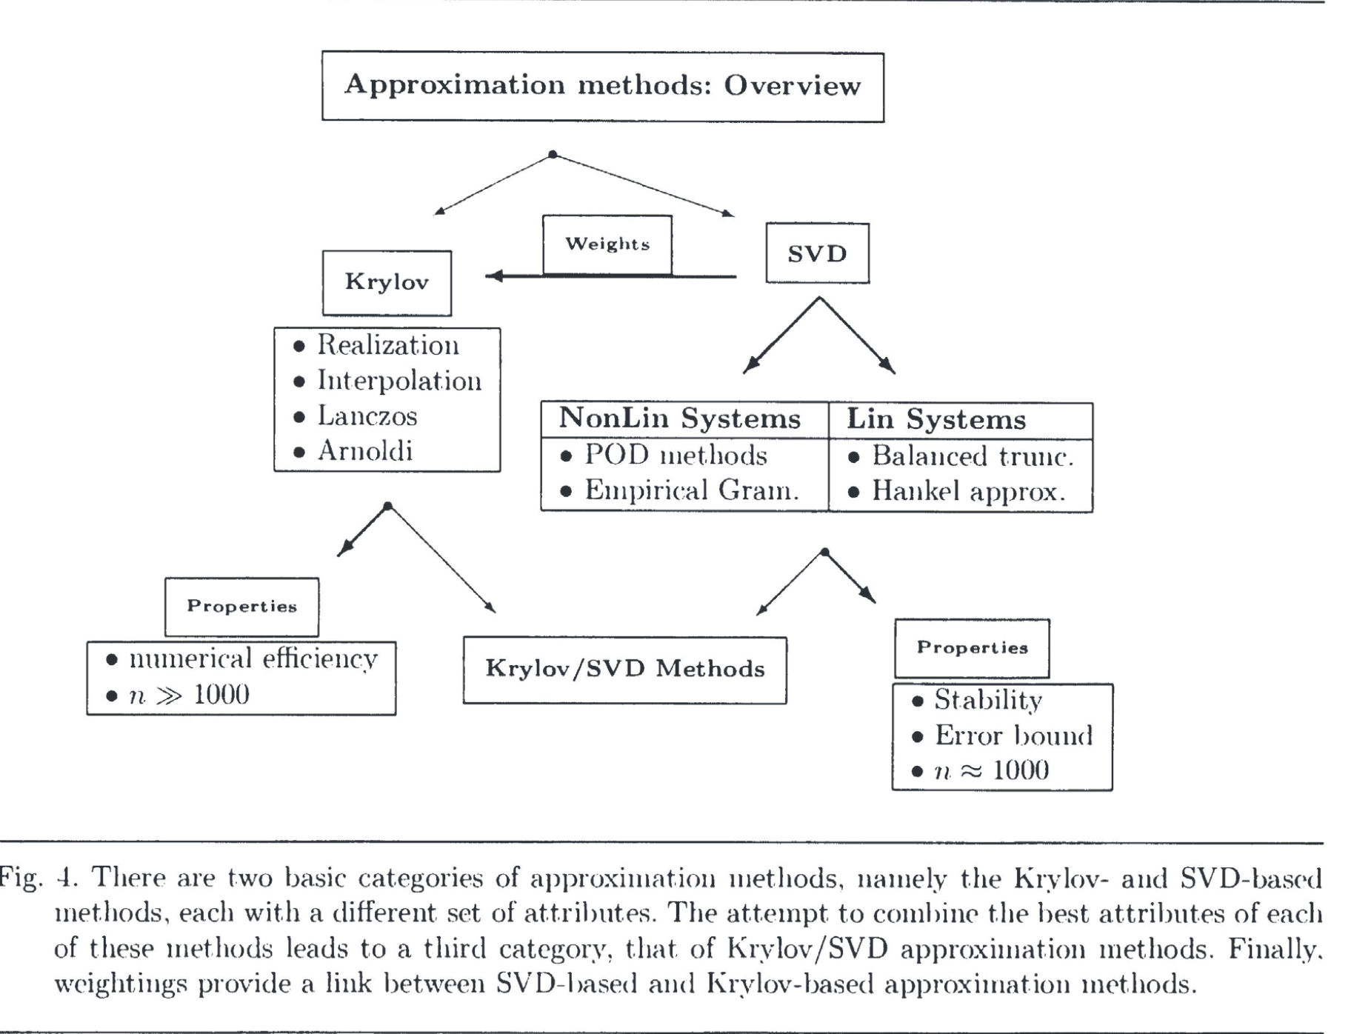
Antoulas, A.C. 2004

Slide 12
How it fits together
Results from the ATM will be used to develop reduced order model to integrate into the Department of Energy (DOE) Energy Exascale Earth System Model (E3SM) Land Model (ELM).
E3SM ELM
Global Scale Climate Model
10km resolution
Results of ATM can provide information on changes to landscape position which (in part) has controls on water, carbon, and energy fluxes in arctic that is missing in E3SM ELM

Slide 13
Why is it important
Other Scientists/Models want to know about changes in water, carbon, and energy fluxes.
Decision Makers want to know about the potential changes in landscape composition for wildlife management

Slide 14
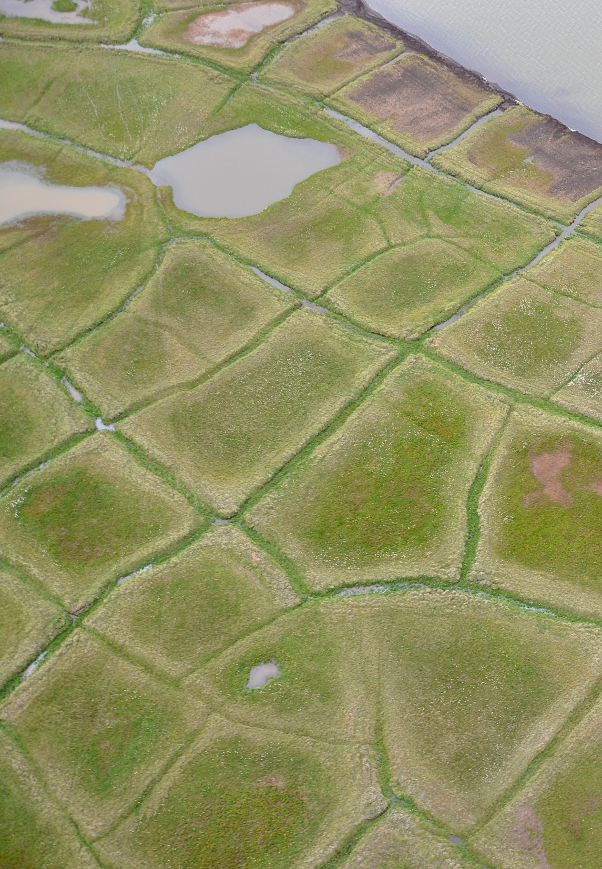
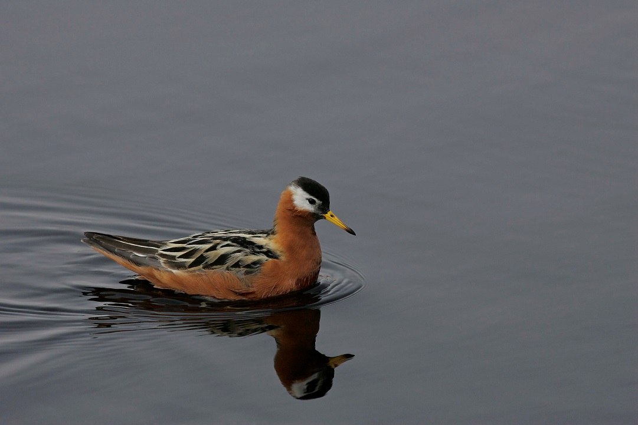
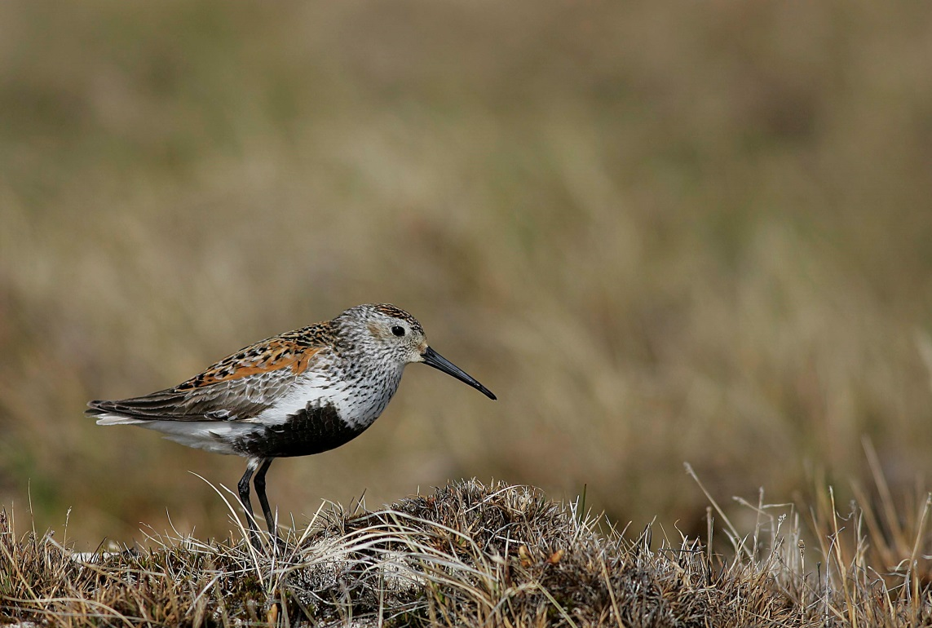
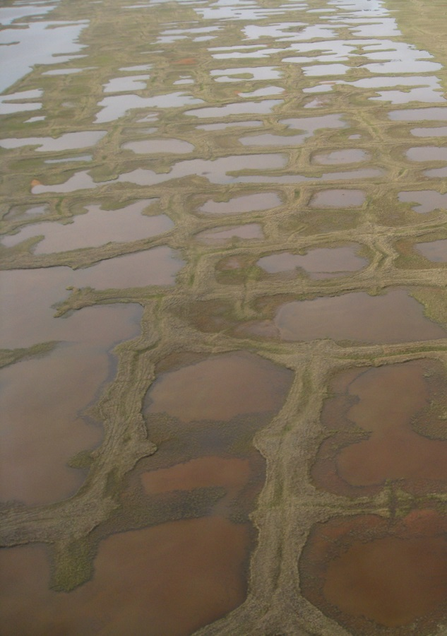
Q_{h}
CH₄
CO₂
Q_{e}
Q_{e}
Q_{h}
CO₂
CH₄
Philip Martin

Slide 15
Tentative Timeline
Spring 2019
Finish polishing/ testing ATM
Summer-Fall 2019
Work on ROM
Fall 2019-Spring 2020
Project writeup
May 2020
graduate

Slide 16
Sources
Definitions of thermokarst terms:
https://www.sciencedirect.com/topics/earth-and-planetary-sciences/thermokarst
Explanation of Reduced order models
Antoulas, A.C. (July 2004). "Approximation of Large-Scale Dynamical Systems: An Overview". IFAC Proceedings Volumes. 37 (11): 19–28
https://www.sciencedirect.com/science/article/pii/S1474667017315847?via%3Dihub

